Slide 1
Launch EC2 instance in AWS

Slide 2
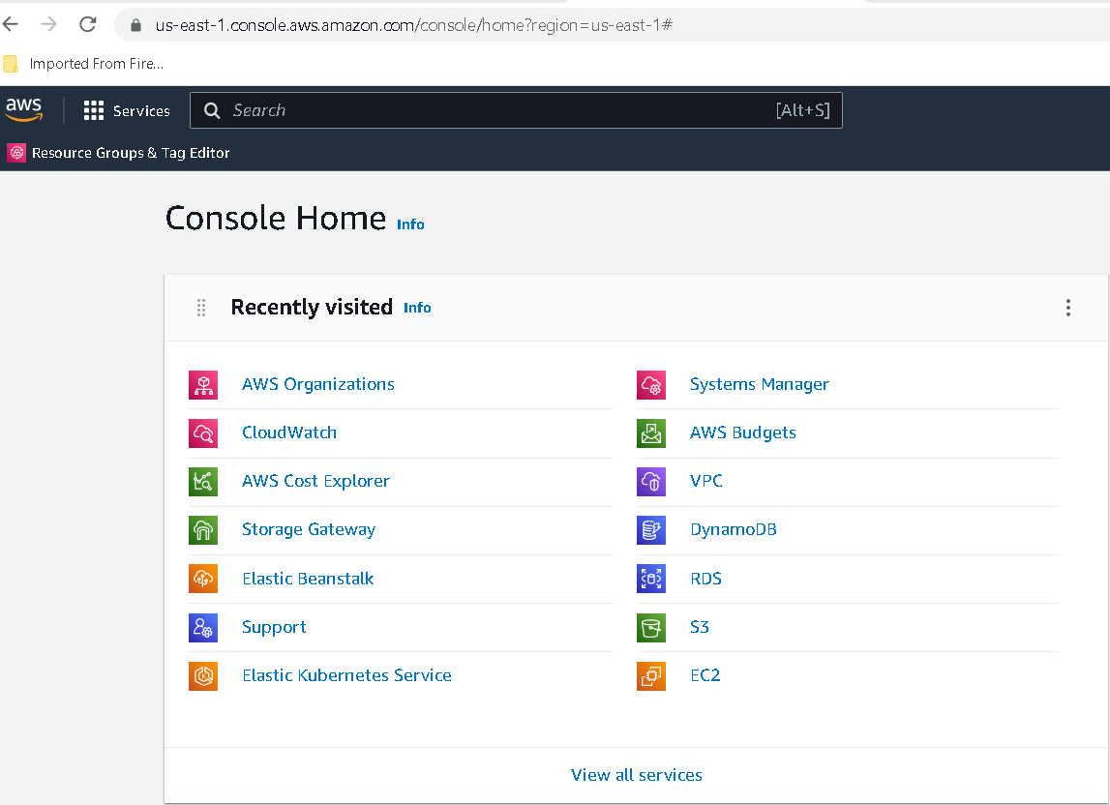
Now we do the login for aws

Slide 3
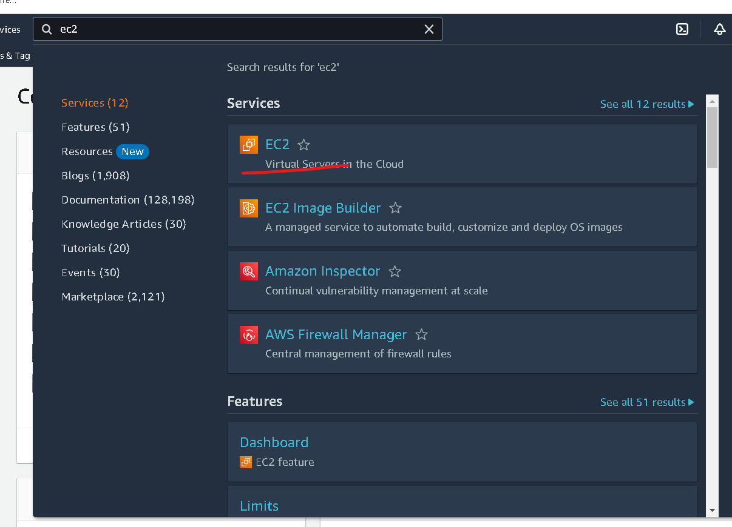
In Search bar search EC2 instance

Slide 4
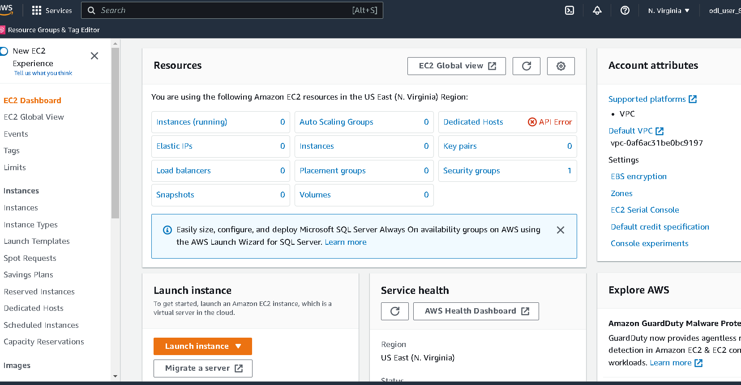

Slide 5
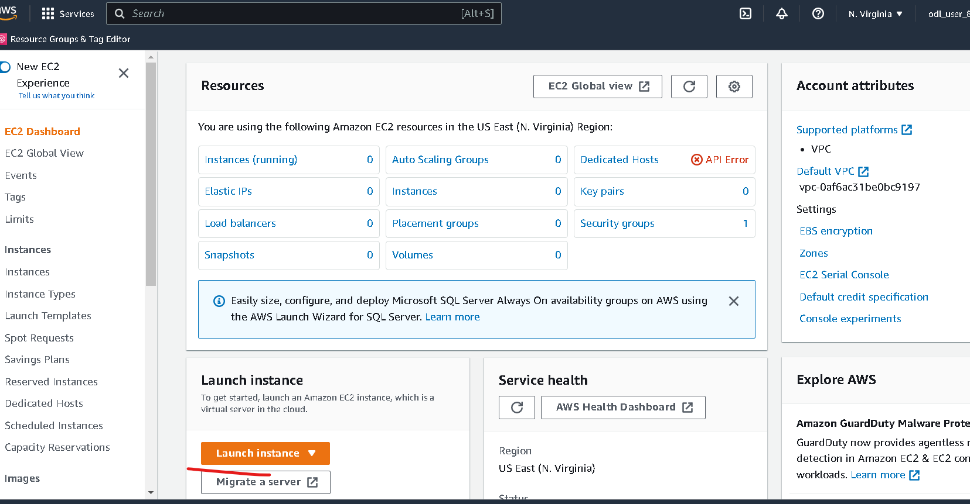
Now you have to click on launch button

Slide 6
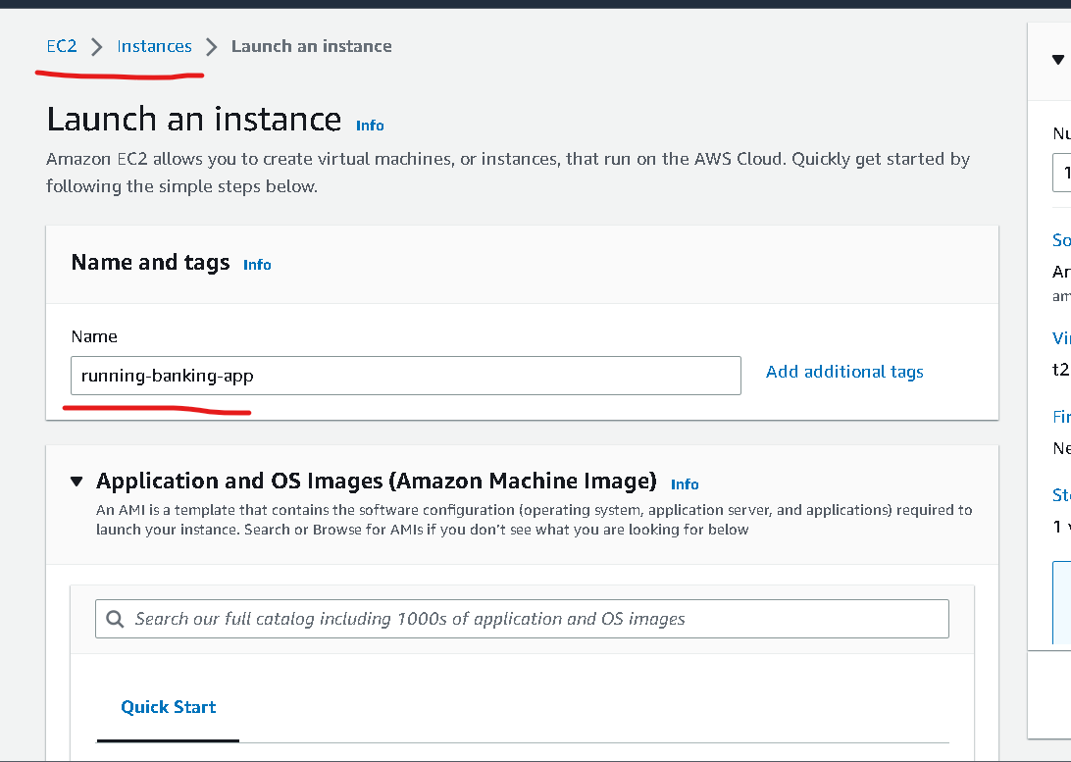
Instance name can be anything :phase2-instance

Slide 7
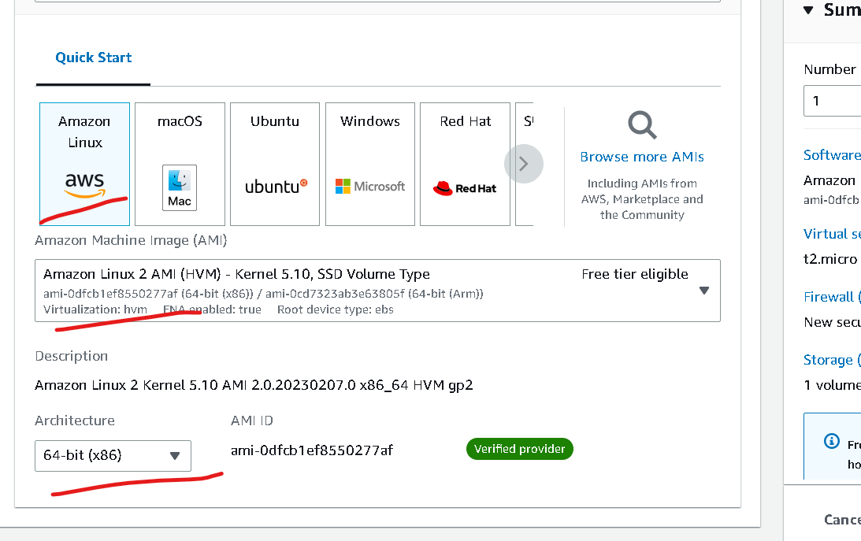
No changes – default option

Slide 8
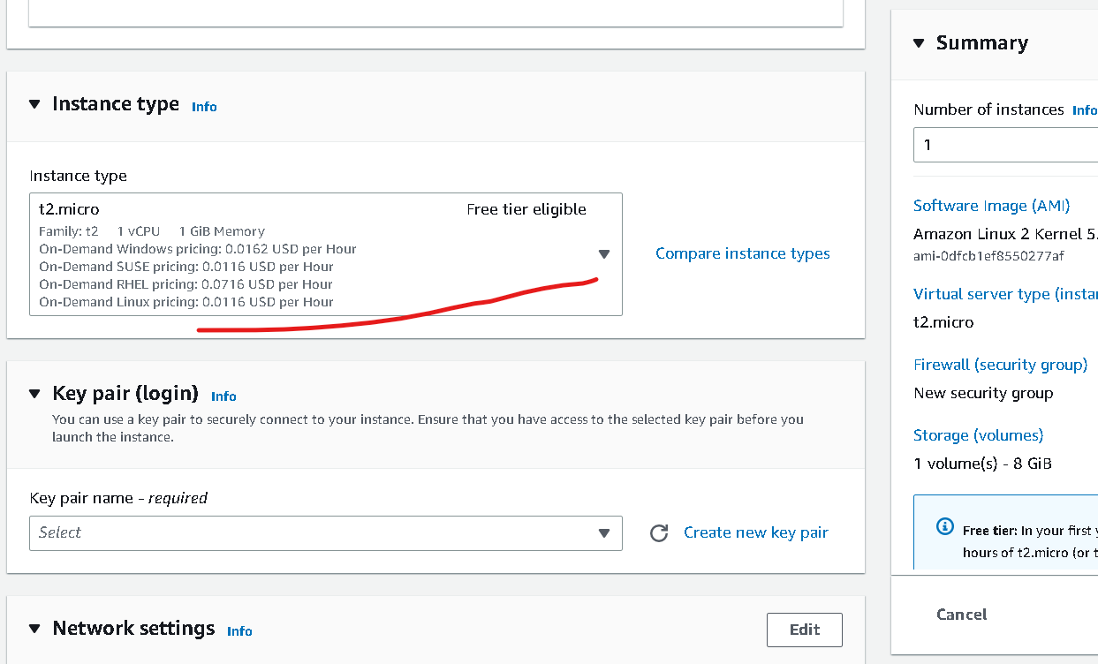
Instance type – free tier (don’t change)

Slide 9
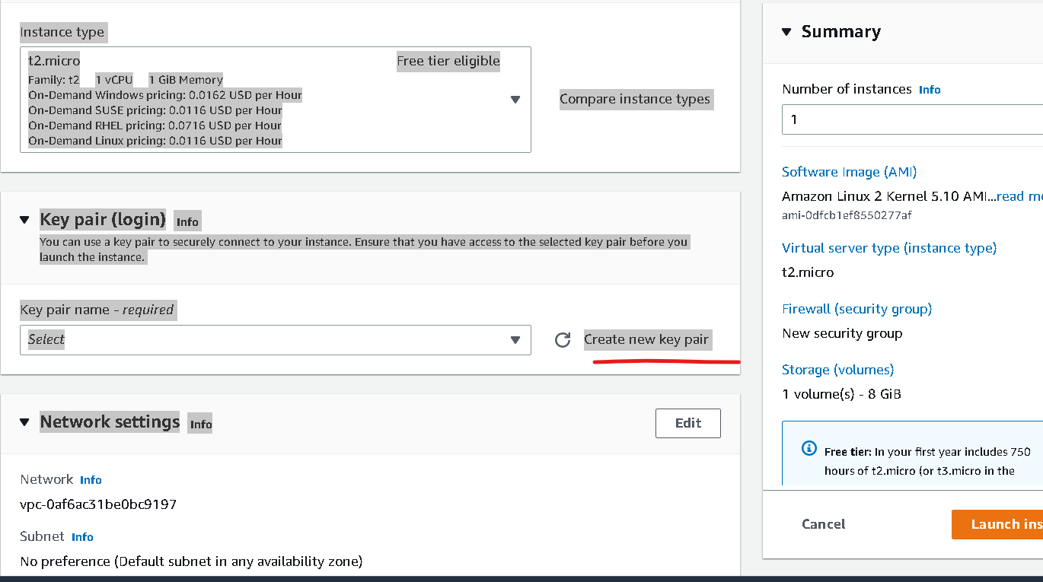
Click on create key

Slide 10
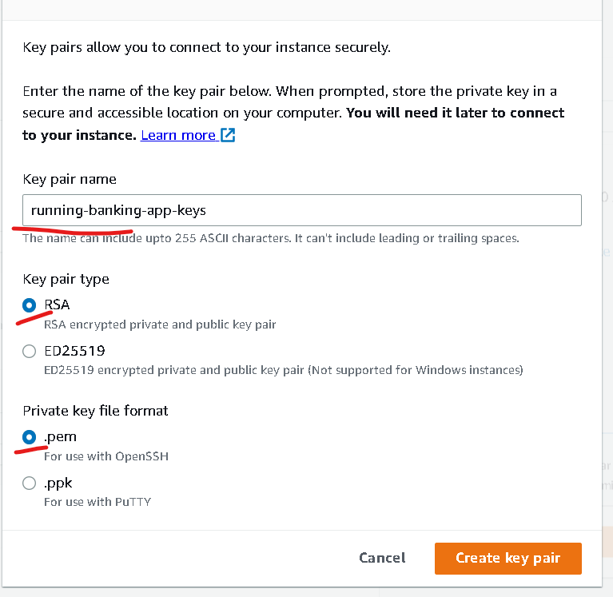
Create the key (please remember path of the file which help to connect to instance )
Keyname is phase2-keys
Private key file format
.pem
If client is SSH client you can create
In MAC or unix we can use normal terminal as SSH client but in window we have to use gitbash which support SSH client
.ppk : this for window with putty tool.

Slide 11
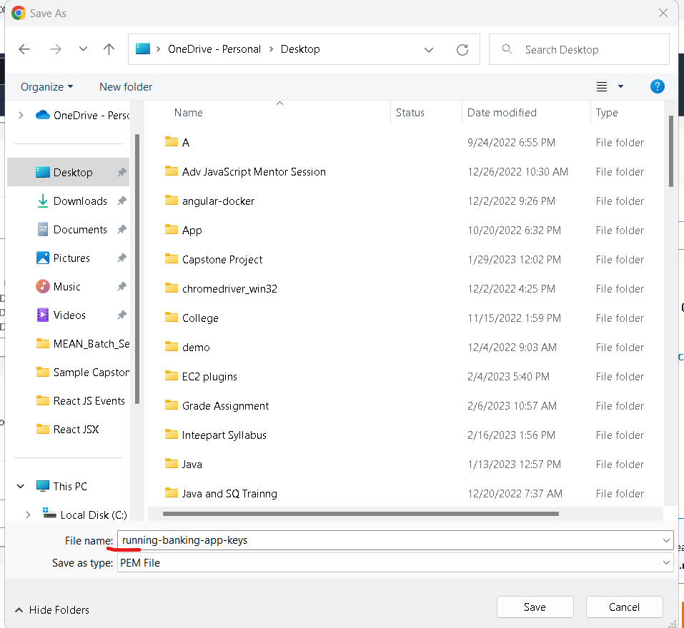

Slide 12
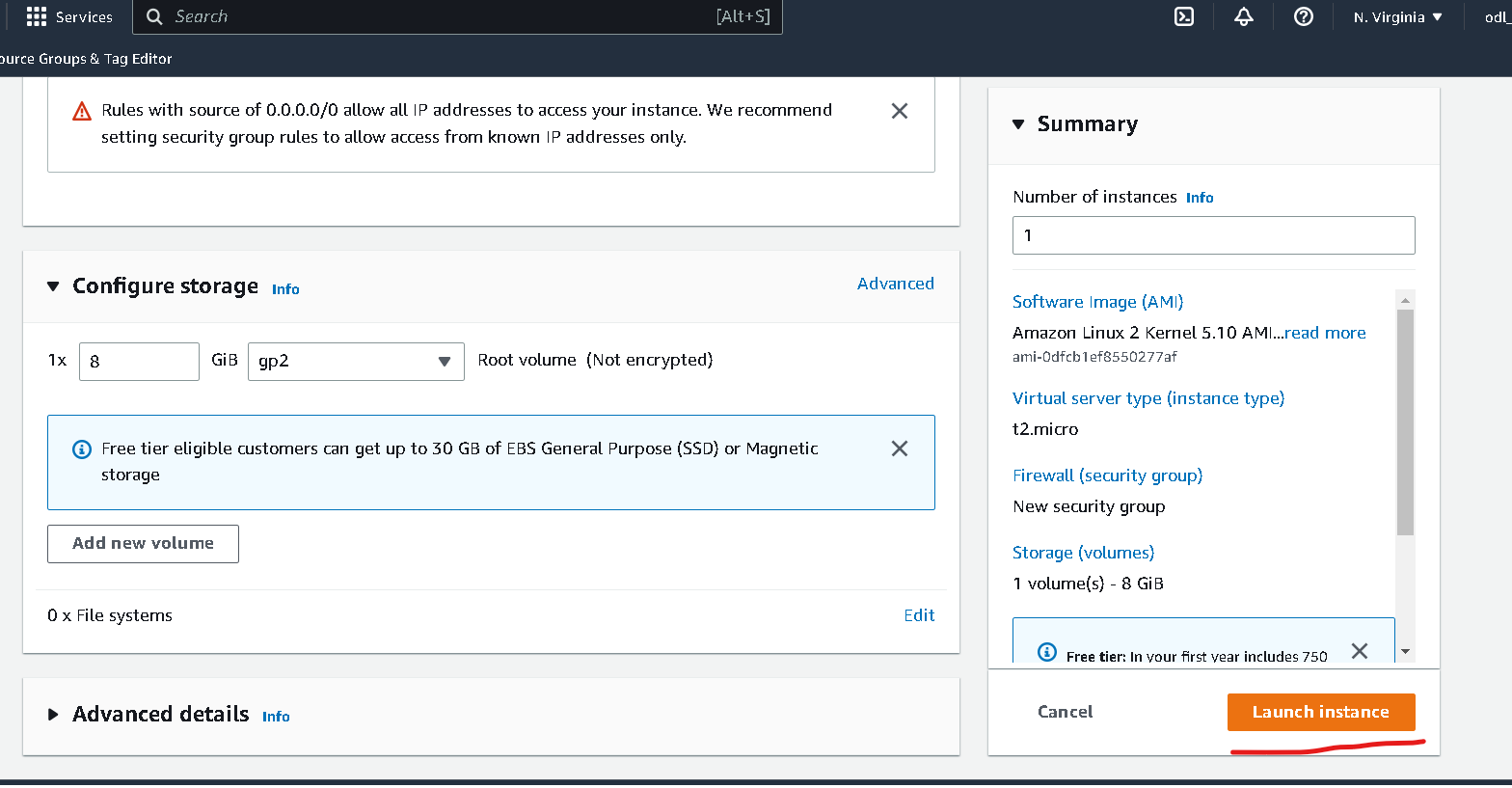
Other option are default don’t do any changes

Slide 13
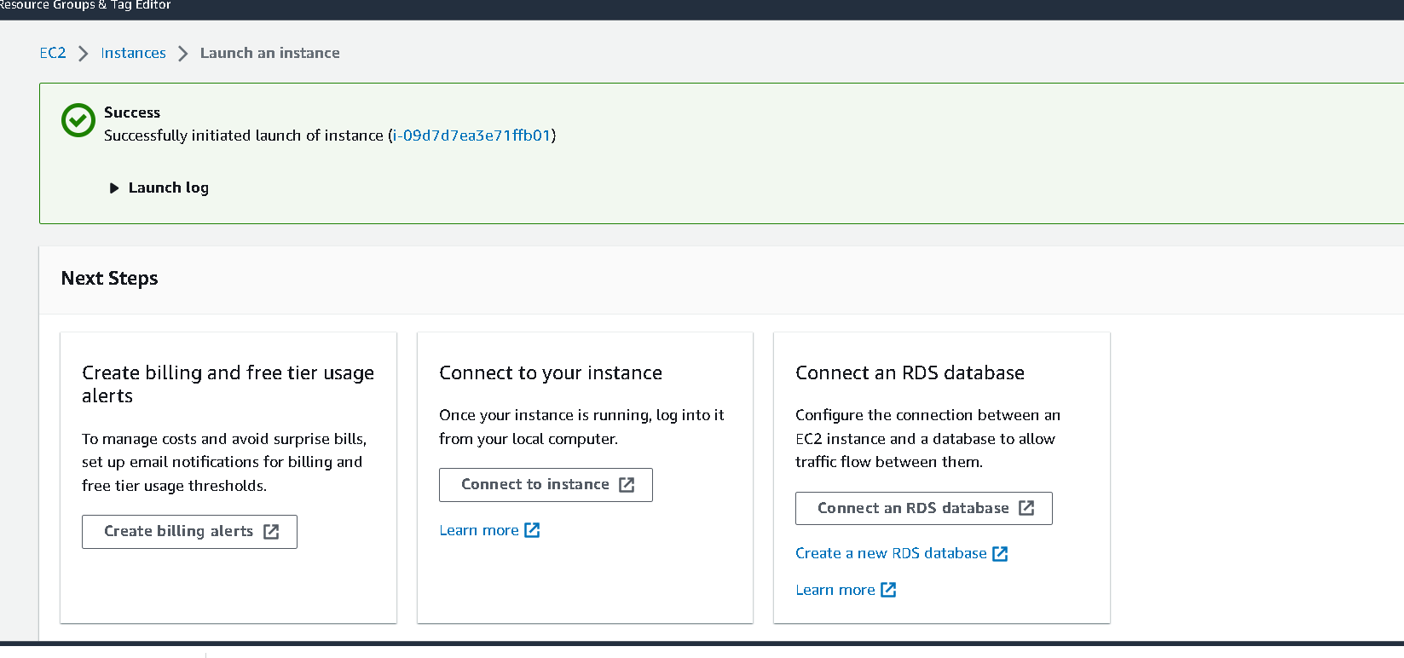

Slide 14
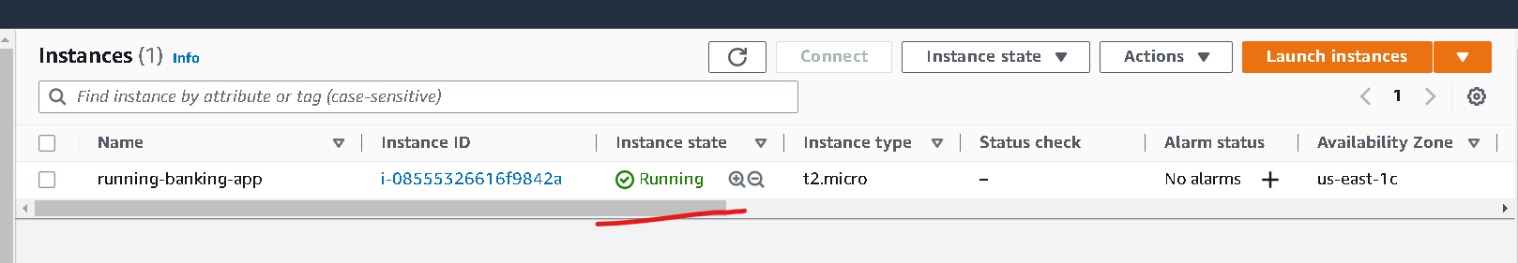
Wait for few minutes to instance to run

Slide 15
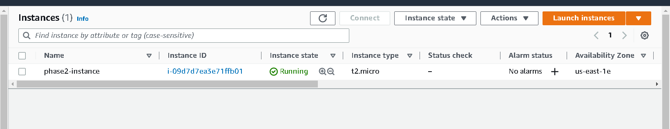
Once instance up

Slide 16
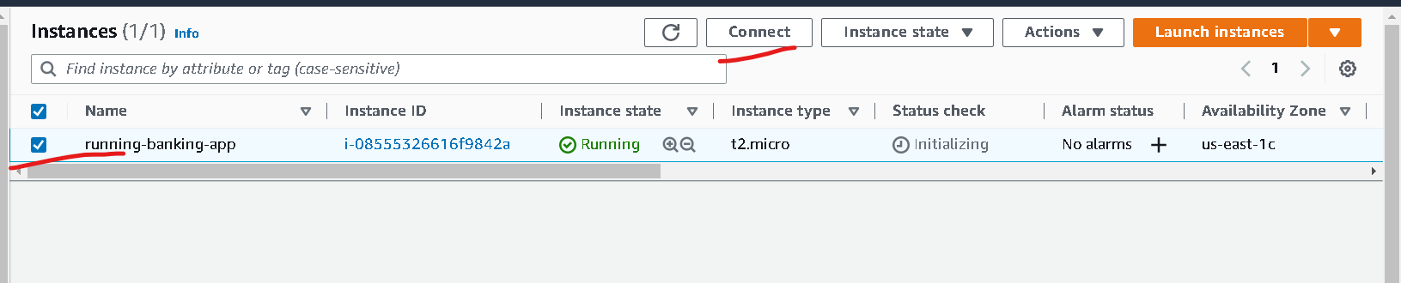
Now click on check box of instance and click on connect

Slide 17
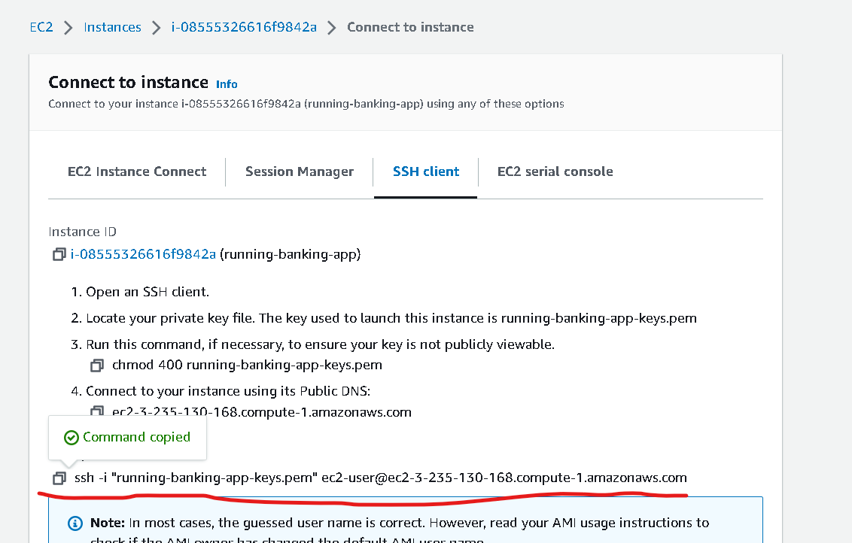
Now you have to copy and example code content which help to connect running instance through ssh client

Slide 18
Steps to connect instance
If you are connecting from window please using gitbash. Open gitbash in the location where .pem file present
If you are connection from unix or mac. Please open terminal in that location where .pem file present.

Slide 19
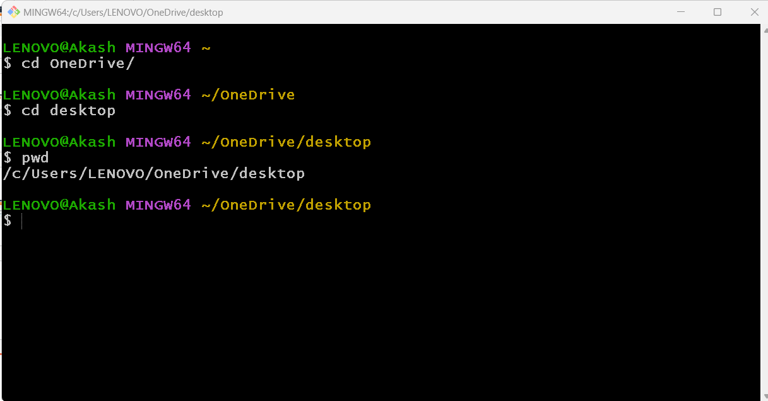
My file present in desktop so I have point to desktop using gitbash

